Slide 1
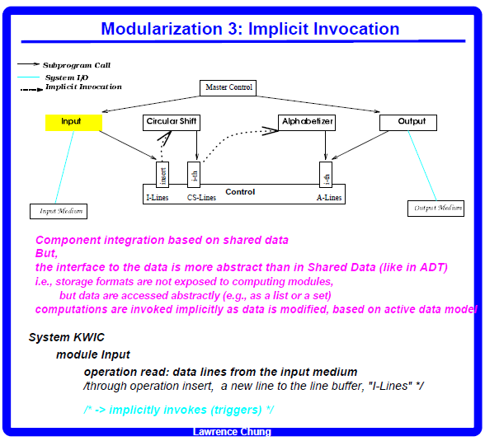
trigger

Slide 2
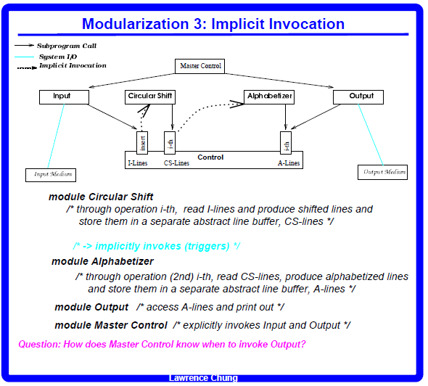
M1 M2
Input;
Output
Beauty and the beast
Beauty beast
Beauty beast
Beast Beauty
Beauty beast
Beast Beauty
NE
10% purchase price
< 10%

Slide 3
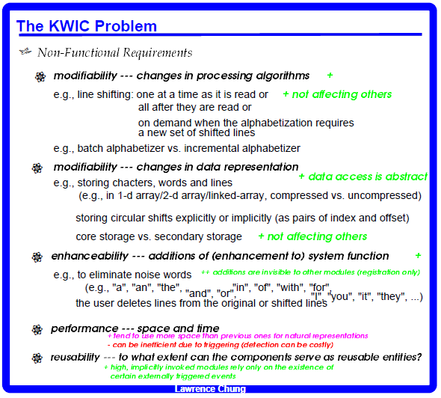

Slide 4
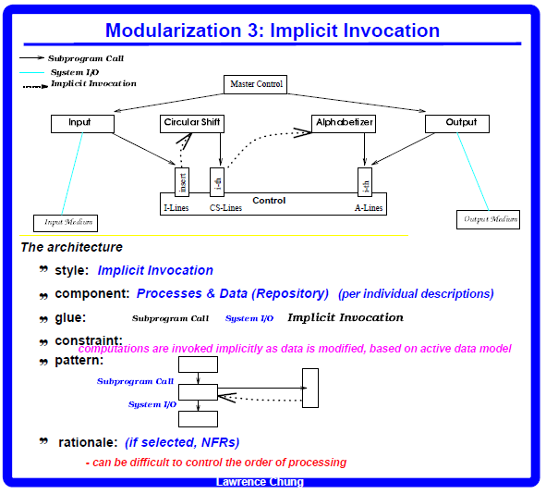

Slide 5
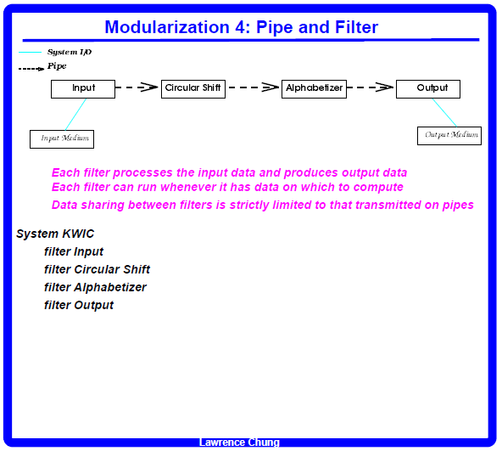

Slide 6
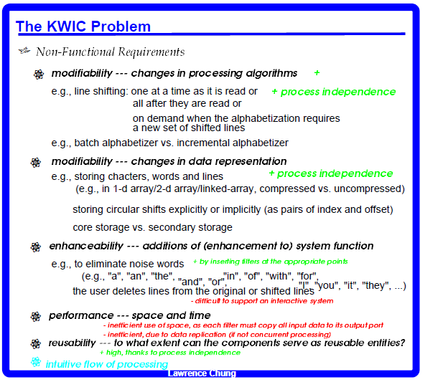

Slide 7
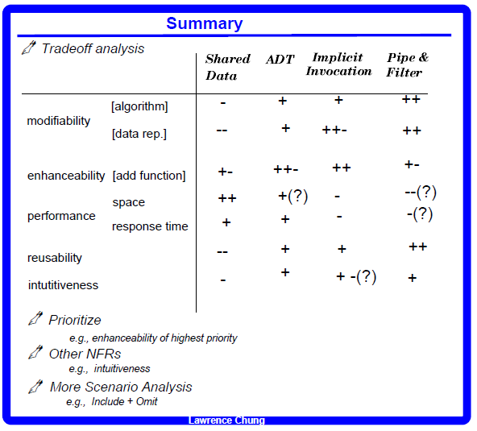

Slide 8
